Slide 1

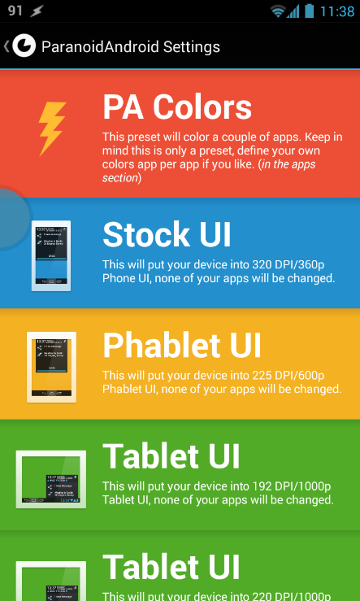
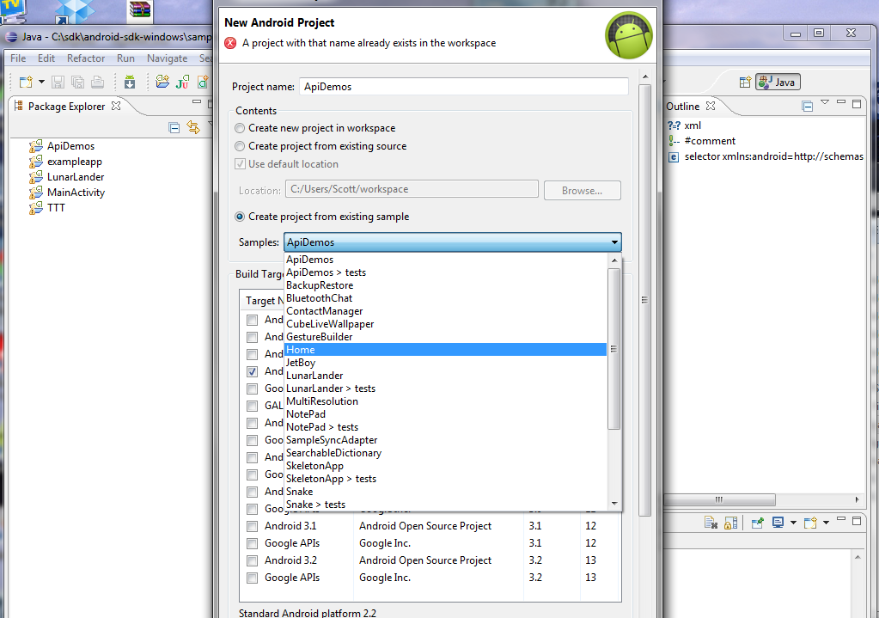
Android Layouts
Dimitar Ivanov
Android Mobile Applications
Telerik Software Academy
http://academy.telerik.com

Slide 2
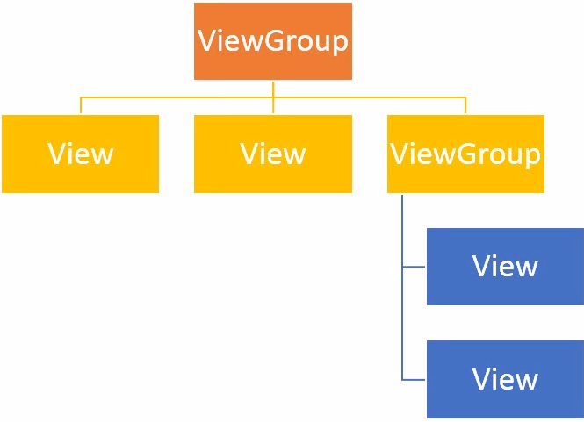
Linear Layout
What’s a View ?
An object that takes rectangular area on the screen and is responsible for handling events in that area
What’s a ViewGroup ?
An object that surrounds the view and is invisible and is responsible for holding the views
In a certain fashion

Slide 3
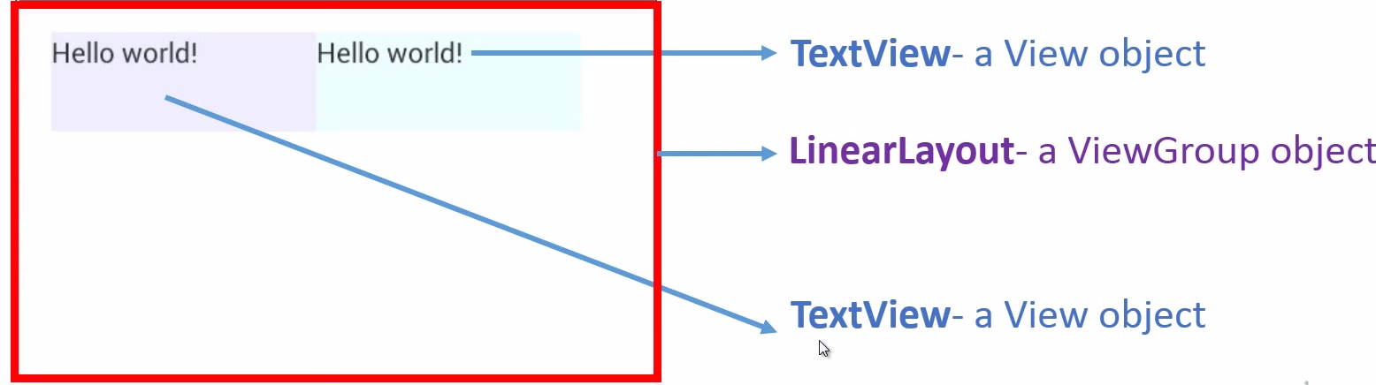
Linear Layout

Slide 4
Relative Layout
What is a RelativeLayout ?
Specify where the View will be placed with respect to some other View or Parent
Layout weight and gravity do no exist in relative layout
A relative layout that is not the root nad is nested inside some other layout may have a Layout weight

Slide 5
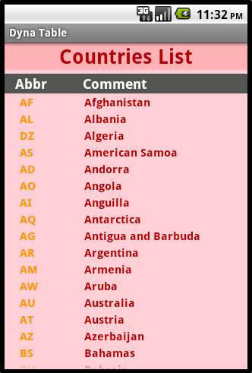
Table layout

Slide 6
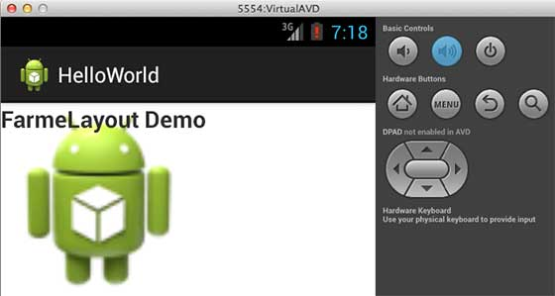
Frame Layout

Slide 7
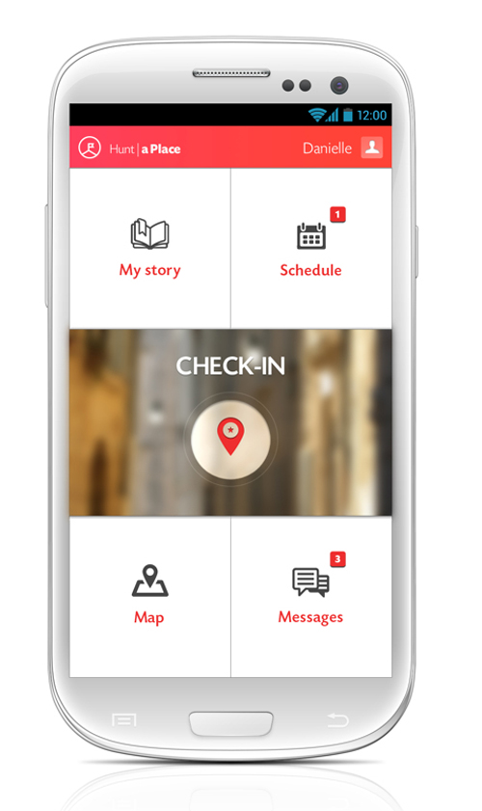
Live Demo

Slide 8
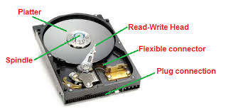
Read/Write data
Read image file from assets.
Read/Write text file to android system

Slide 9
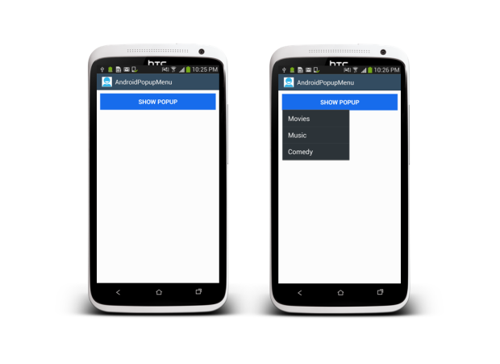
Using Popup

Slide 10
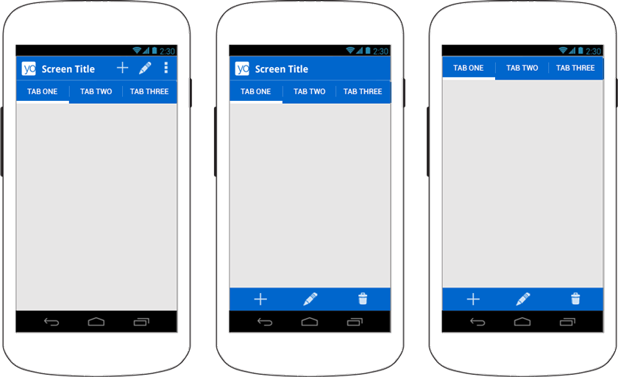
Customizing/Using action bar

Slide 11
Android Getting Started
http://academy.telerik.com

Slide 12
Homework
Make activity with three imageview widgets
Clicking on each image should provide popup with additional information for the image, for example (image size,animal name,link refer,etc…)

